Slide 1

Swiss Association of Trust Companies
Geneva, 25 May 2016

Slide 2
Agenda
I | Initial situation
II | The new supervisory regime
III | Serious tax offences as predicate offence to money laundering
IV | CRS for trusts and trustees
V | Concluding remarks

Slide 3
I. Initial situation

Slide 4




I. Initial situation
Regulation is increasing dramatically

Slide 5





I. Initial situation
Increasing pressure from abroad

Slide 6
I. Initial situation
Regulation projects
International regulations
Cross border rules
MiFID
MiFID II
Taxation of savings agreement
CRS/AEI
FATCA
National regulations
AMLA / Code of ethics
FinSA
Self-regulation
FinIA
CDB/AML
AML-Reform 16
Collective Investment Schemes Act, CISA
2014
2015
2016
2017
2018

Slide 7
II. FinIA: The new supervisory regime

Slide 8
II. FinIA: The new supervisory regime
The Cascade
Prudential supervision by FINMA
Prudential supervision by the new supervisory organisation
Code of conduct / due diligence obligations
Bank
Portfolio managers, trustees und
precious metal dealers
Investment advisors, distributors etc.
Supervisory intensity
Regulatory requirements
Securities firms
Fund manager
Managers of collective assets
(CISA and pension funds)
Approx. 2,500 new authorisations

Slide 9
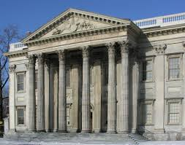

II. FinIA: The new supervisory regime
Supervisory organisation: structure
FINMA
(supervision of the SO )
FINMA
Supervision
Board of directors
Audit
BoD
not
Senior management
Senior management
(directors)
Operations
Depart-
ments
Authorisation
Supervision / enforcement
ICS /
regulations

Slide 10

II. FinIA: The new supervisory regime
Supervisory organisation: supervisory instruments
Granting and withdrawal of licences;
Direct auditing possible;
Approval of auditors;
  In principle: Financial institutions subject to annual audit;
  but: Audit frequency may be increased to four years;
Issuing of circulars setting out Federal Council’s provisions (circulars require FINMA approval);
Financed by fees and supervisory charges.
  Not: Appointment of an investigating agent or imposition of a professional ban!

Slide 11

II. FinIA: The new supervisory regime
Licensing conditions: all institutions
Appropriate corporate governance rules;
Compliance with statutory requirements;
Effective internal control system (ICS) commensurate with risks taken;
  To measure, control and monitor risks
Effective management of firm from Switzerland;
Guarantee of a proper business conduct.
Appropriate organisation
Risk & compliance

Slide 12





II. FinIA: The new supervisory regime
What has to be done? Overview of potential courses of action
Assessment phase
Evaluation of strategy
Implementation of strategy
Licensing phase
Strategic review
"Solo attempt"
Business model / Processes
Cooperation
Loose cooperation vs. merger
Outsourcing
Evaluation & partnership
Timeframe:
1-2 months
3-6 months
12-18 months
Authorisation
from 1.1.2018

Slide 13
II. FinIA: The new supervisory regime
Assessment phase - strategic review
All dimensions to be considered
Asking the right questions…
... from a legal perspective:
What are the organisational requirements of the new SO?
Do my processes satisfy the new regulations?
Cross-border operations – what must I take into account?
Under what conditions are licences granted?
etc.
... general and organisational issues:
How high are the regulatory costs?
What options do I have?
How do they impact the implementation?
etc.
Regulatory framework
FinIA
AMLA/AIA/FATCA
FinSA/MiFID II
Strategy
Client structure
Documents & forms
Internal directives
Processes
Business model
Organisation
Investment philosophy
Pricing model
Custodian banks
Organisation

Slide 14
II. Serious tax offences as predicate offence to money laundering

Slide 15
III. Serious tax offences as predicate offence to money laundering
Content
Swiss principle:
Felony as defined in Art. 10 para. 2 of the Swiss Criminal Code as predicate offence to money laundering
(custodial sentence of more than three years)
Art. 305^{bis} para. 1 and 1^{bis} of the Swiss Criminal Code:
Tax fraud according to Art. 186 of the Swiss Federal Act on Direct Federal Taxation (DBG) as a predicate offence to money laundering
Any person who uses a falsified or forged certificate or a certificate with an untrue content in order to deceive another.
Evaded tax must total more than CHF 300,000 per tax period.
(Even if the misdemeanours were committed abroad! )

Slide 16

III. Serious tax offences as predicate offence to money laundering
Actions
Codes of conduct for employees
Identification of the nature and purpose of the business relationship or the transaction (special due diligence duties according to Art. 6 para. 2 lit. b AMLA)
  No obligation to prove predicate offence
  Evaded tax does not have to be calculated exactly
Duty to file a report with the Money Laundering Reporting Office Switzerland (MROS) if FI knows or has reasonable suspicions
Obligation to implement criteria for identifying and monitoring serious tax offences:
Maximum tax rate of each country where the clients are domiciled for tax purposes (Art. 21 AML-Ordinance FINMA)

Slide 17
III. CRS for trusts and trustees

Slide 18

IV. CRS for trust and trustees
Overview
Private client
1
2
3
Practical implementation
Corporate client
Person to be reported
Reporting financial institution
Swiss tax authorities
Foreign tax authorities
1
FI identifies the person to be reported, their accounts and collects appropriate data.
2
FI reports the collected data to the Swiss tax authorities.
3
Information exchange between Swiss and foreign tax authorities.
Information flow
  Challenge for Swiss financial institutions:
  Tax conformity vs. Data security/ protection
  Data levying and data quality (+ Change Management)

Slide 19

IV. CRS for trust and trustees
The trustee: Qualification as Financial Institution
Entities that qualify as Financial Institutions:
Depository institutions
Custodial institutions
Specified insurance companies
Investment entities
  Entities investing, reinvesting or trading in financial instruments, portfolio management or investing, administrating or managing financial assets
Corporate trustees

Slide 20

IV. CRS for trust and trustees
The Trust: Qualification as Financial Institution
Trust qualifies as a Financial Institution if:
the trust or its financial assets are professionally managed, e.g. by a corporate trustee qualifying as a financial institution; and
the trust's gross income primarily results from trading, investment, or re-investment of financial assets.
(otherwise: the trust qualifies as a passive NFE)

Slide 21

IV. CRS for trust and trustees
The Trust: reporting financial institution?
Trust qualifies as Reporting Financial Institution if:
the trust is resident in a Participating Jurisdiction;
  it will be considered to be resident where the trustee(s) is (are) resident
  (could be more than one! Multiple reports possible!)
and does not qualify as a Non-Reporting Financial Institution:
  where the trustee itself is a Reporting Financial Institution and undertakes all information reporting in respect of all Reportable Accounts of the trust (trustee documented trust)
Trustee is the reporting institution for the trust (and not the bank where the assets are held)

Slide 22


IV. CRS for trust and trustees
Qualification as Financial Institution: Persons to be reported
Determination of persons who qualify as holding an equity interest in a trust:
Settlor
Beneficiaries
  Mandatory beneficiary
  Discretionary beneficiary
  (only in the years in which they receive a distribution from the trust!)
Or any other individual exercising ultimate effective control over the trust
chain of ownership/control other than direct control
Not: Trustees and protectors (see chap. 3.5 Draft Guidance FTA)

Slide 23
IV. CRS for trust and trustees
Qualification as Financial Institution: Reporting the relevant information
The account information to be reported for each reportable Person includes:
Name
Address
Residence
TIN-Number
Date of birth
Account number (unique identification number for each Equity Interest Holder that will enable the trust/trustee to identify the subject of the report in the future)
Type of Controlling Person (e.g. beneficiary, settlor, others)

Slide 24
IV. CRS for trust and trustees
Qualification as Financial Institution: Financial activity to be reported
Account holder | Account balance or value | Gross payments
Settlor of a revocable trust | Total value of all trust property | Value of payments made to the settlor in reporting period (if any)
Settlor of an irrevocable trust | Nil | Nil
Beneficiary: mandatory | Total value of all trust property | Value of distributions made to the beneficiary in reporting period
Beneficiary: discretionary (in a year with distributions) | Nil | Value of distributions made to the beneficiary in reporting period
Any other person exercising ultimate effective control | Total value of all trust property | Value of distributions made to such person in reporting period (if any)

Slide 25

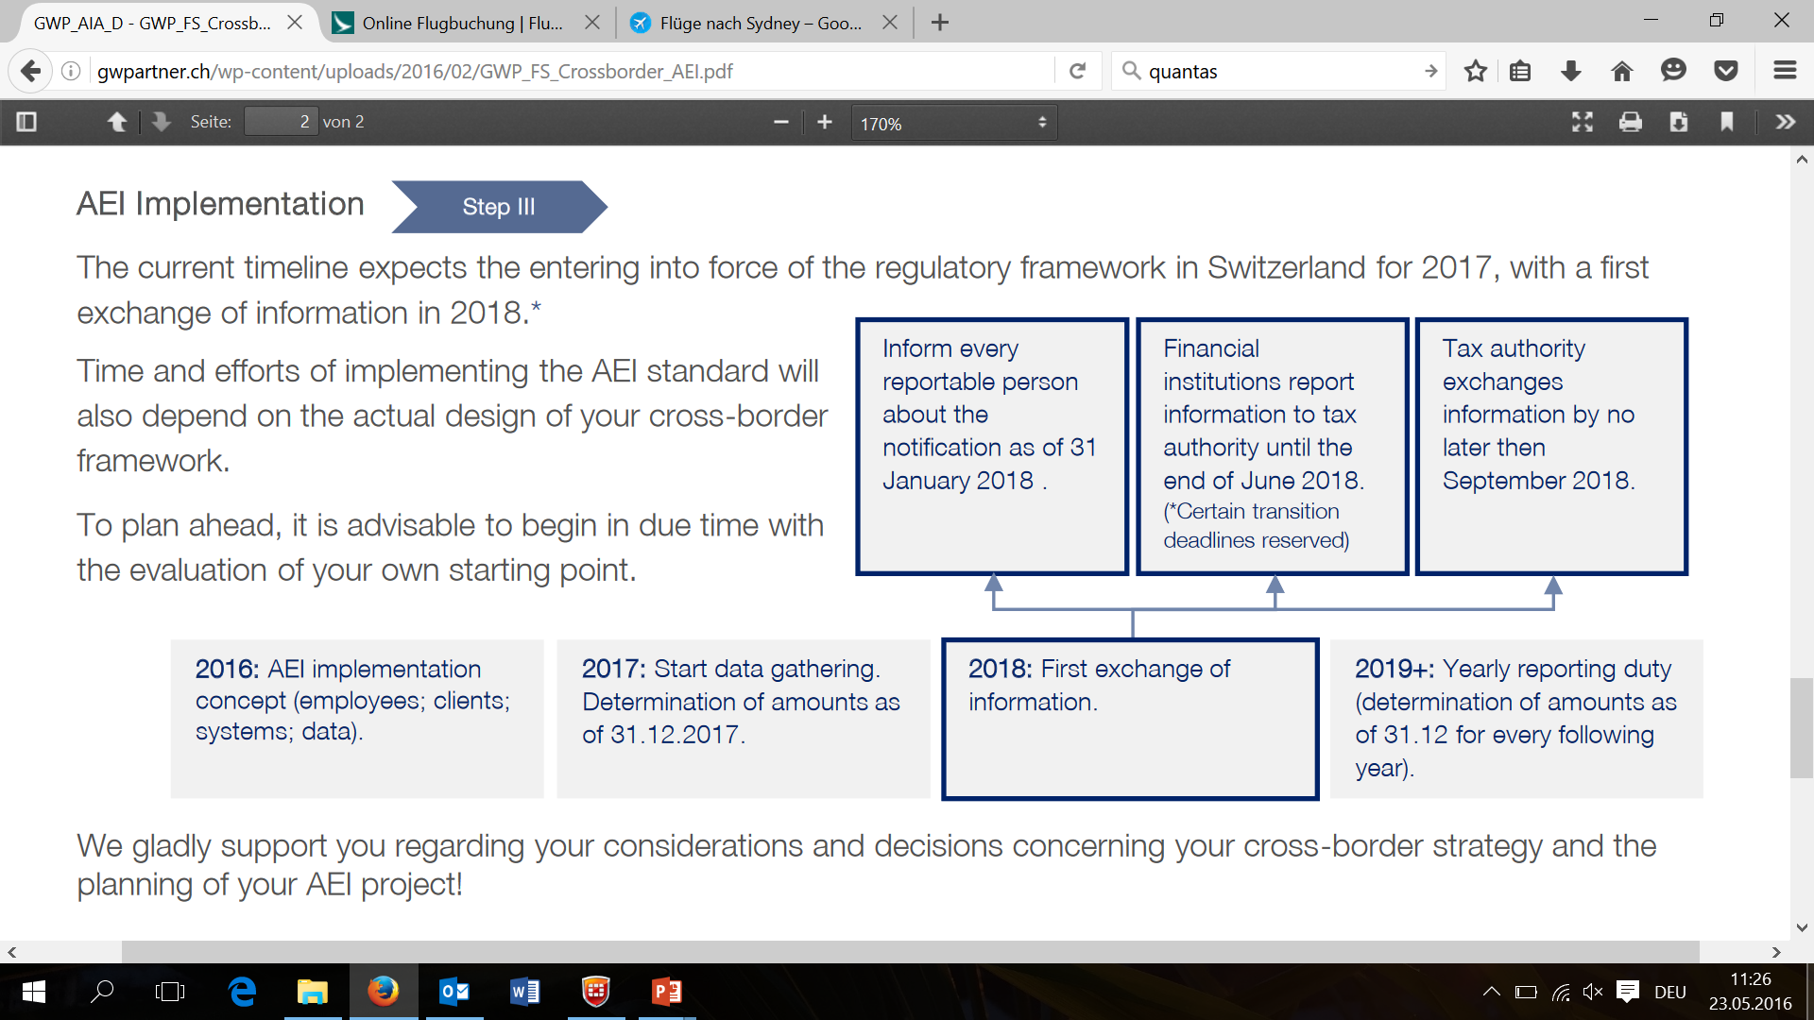
IV. CRS for trust and trustees
Timeline
Dec. 2015: AEI-Law was adopted
Apr. 2016: Deadline for referendum expired
May 2016: Consultation on ordinance until Sep. 2016
Guideline from FTA in progress

Slide 26
IV. Concluding remarks

Slide 27


IV. Concluding remarks (I)
AMLA – FATCA – CRS – FinSA - FinIA
Governance
IT processes
Data quality
Monitoring /
Reporting
Coordination
Use of synergies

Slide 28



IV. Concluding remarks (II)

Slide 29
Many thanks for your attention!

Slide 30
About us
“Our goal is to develop tailor-made, effective solutions for our clients. We work pragmatically to reduce the complexity of problems and find suitable solutions.”
Geissbühler Weber & Partner support you in meeting the new financial market legal requirements and in optimising existing compliance & risk processes. We provide you with support in solving specific regulatory issues as well as complete solutions, from planning and implementation all the way to the follow-up guidance.
With an experienced team of 20 people, Geissbühler Weber & Partner provides services to financial service providers in the fields of financial market regulation, due diligence and analysis, compliance and risk, and IT compliance.

Slide 31
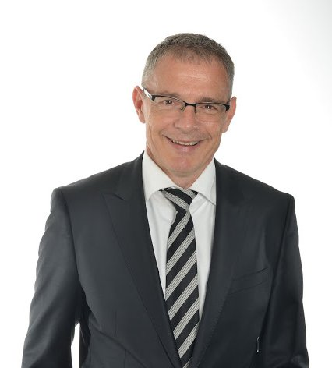
Alex Geissbühler
Partner, Attorney at Law
Alex Geissbühler is a lawyer and managing partner at GW&P with more than 18 years’ experience in the financial sector.
Thanks to his extensive experience and wide-ranging specialist knowledge of the regulatory environment, he is ideally positioned to recognise key risks quickly and identify effective, pragmatic solutions.
Alex Geissbühler has managed a range of projects to implement new supervisory regulations (e.g. AMLA, FATCA, MiFID) and develop efficient compliance structures. He is also renowned as an expert in upcoming financial market regulations, notably FinSA and FinIA.
Alex Geissbühler works for the US Tax Program as an independent examiner at various banks, and has been appointed by FINMA as an investigator on many occasions.
Capco (1 year)
KPMG (13 years)
Berner Kantonalbank (4 years)

Slide 32
Alex Geissbühler
Geissbühler Weber & Partner
DIANASTRASSE 9 – 8002 ZURICH
T. +41 44 221 91 01 – M. +41 79 196 71 45
alex.geissbuehler@gwpartner.ch
http://gwpartner.ch/en/

